Slide 1



Crime and Emergency Response Analysis
Exploring how crime patterns and emergency response efficiency vary across New York City boroughs.
BA780 Final Presentation
Team 05 - Ahrar Karim, Shengqi Wei, Tanmay Yenge, Mokhinur Talibzhanova, Michael Allieri.

Slide 2


Crime in NYC
2014 | “NYC murders hit a 50-year low” — Reuters New York celebrated its safest year since 1963 — a calm before the post-pandemic reversal.
2019 | “4 Killed and 3 Injured in Brooklyn Shooting” — Time
Four people were killed and three injured in a shooting in Brooklyn, at 74 Utica Avenue. At least 15 shots were fired, and police recovered two guns.
我们，还在路上...
2020 | “NYC response times lag as ambulances wait in line at the ER” — Bloomberg
Ambulatory delays increased ~3 minutes, largely because ambulances queued at hospitals.
总结汇报|工作汇报|工作计划
2022 | “Shootings Down in NYC, Overall Crime Up for 2022” — NBC New York
NYC shootings and murders are down, but overall crime is up for 2022: NYPD reports.

Slide 3
Problem Statement
Cities like New York generate large volumes of crime and emergency data, but these datasets are often analyzed separately rather than together.
Without a combined view, it is difficult to understand how effectively the city responds to emergencies in high-crime areas.
Our project aims to connect crime patterns with emergency response behavior, exploring how neighborhood, time, and demographic factors influence both.
By integrating data from shootings, arrests, 911 calls, and emergency incidents, we analyze whether crime intensity is linked to response efficiency.
The goal is to uncover patterns that support data-driven public safety planning and resource allocation.
我们，还在路上...
总结汇报|工作汇报|工作计划

Slide 4


Motivation — Why This Study Matters
Urban Complexity: New York City is one of the most densely populated and complex cities in the U.S., making public safety and emergency management a constant priority.
Response Efficiency Gap: While crime statistics are widely analyzed, emergency response performance is less studied — especially how it varies across boroughs and time.
Data Integration Challenge: Existing datasets (crimes, arrests, 911, EMS) are rarely combined, limiting the city’s ability to see the whole picture of public safety.
Policy Relevance: Identifying when and where delays occur can help city officials allocate resources more efficiently and improve public trust.
Goal: Provide actionable insights for data-driven public safety management and optimized emergency resource deployment.
数据分析报告
统计分析|运营报告|
时间只不过是考验
种在心中信念丝毫未减
坚持住 就会拥有属于你的蓝图
开始汇报

Slide 5
Our Data Sources
NYPD Shooting Incident Data – crime hotspots & yearly trends
NYPD Arrest Data – offense type, borough, and age group
EMS Response Data – dispatch and response duration
911 End-to-End Data – call handling and system coordination (All datasets are from NYC Open Data portal.)
工作概述
数据分析
目录
用户分析
市场分析
Goal of integration:
➤ Build a unified dataset connecting crime intensity and response efficiency
Coverage:
➤ 5 boroughs × 10+ years of data (2006–2024)
Insight focus:
➤ Understand when and where response delays occur relative to crime levels
财务分析
销售分析

Slide 6

Executive Summary
Crime-Response Link: Boroughs with higher crime intensity (e.g., Bronx, Brooklyn) also show slower EMS response times — indicating possible service strain in high-risk zones.
Temporal Variation: Both crime and emergency activities peak during summer months (June–August), suggesting seasonal resource pressure.
Spatial Disparity: Staten Island remains consistently low-risk, while Brooklyn and Bronx dominate overall incident volume.
Demographic Focus: The 25–44 age group accounts for the majority of arrests, aligning with the city’s working-age population and potential socioeconomic drivers.
Policy Implication: These insights highlight the need for borough-specific planning, combining public safety management with data-driven resource deployment.
工作概述
数据分析
目录
用户分析
市场分析
财务分析
销售分析

Slide 7
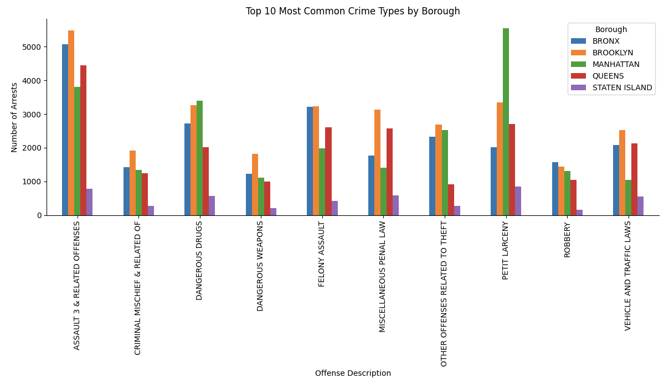

工作概述
数据分析
目录
用户分析
市场分析
财务分析
销售分析
Assault-related offenses dominate, especially in Brooklyn and Bronx, signaling persistent violence pressure zones.
Manhattan leads in petit larceny — theft concentrated in retail and tourist districts.
Drug and weapon arrests cluster in Bronx/Brooklyn, suggesting deeper social and enforcement dynamics.
Staten Island remains consistently low-risk with limited offense diversity.

Slide 8
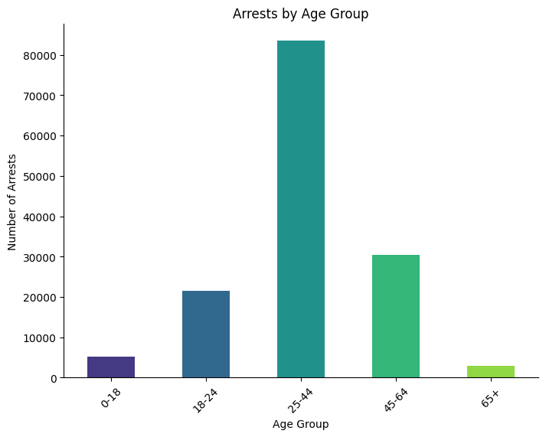
工作概述
数据分析
目录
用户分析
市场分析
财务分析
销售分析
65 plus ~3k far below 45 to 64 ~31k Interpretation specialized senior dockets likely low impact relative to adult services.
25 to 44 is about 84k the largest while Interpretation focus reentry employment and supervision on 25 to 44.

Slide 9
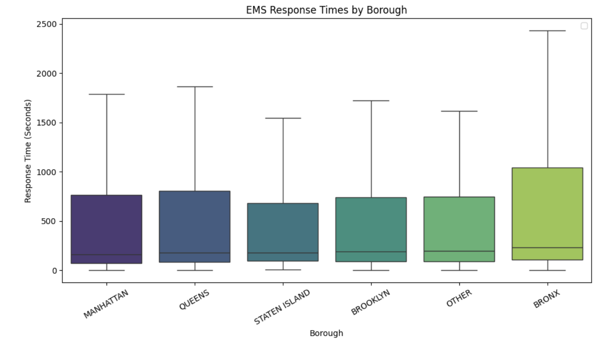
工作概述
数据分析
目录
用户分析
市场分析
财务分析
销售分析
Bronx & Brooklyn: Slowest EMS response — high service strain.
Manhattan: Fast, stable response — dense resource network.
Pattern: More crime → slower response.
Implication: Need adaptive, borough-specific EMS planning.

Slide 10
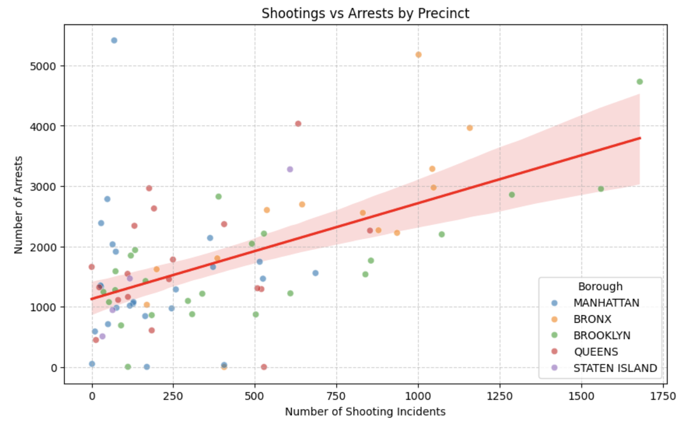

工作概述
数据分析
目录
用户分析
市场分析
财务分析
销售分析
Strong positive correlation: more shootings → more arrests, reflecting proportional law enforcement response.
Brooklyn and Bronx clusters dominate high-shooting, high-arrest zones.
Wider variance at upper ranges suggests uneven arrest efficiency among precincts.

Slide 11
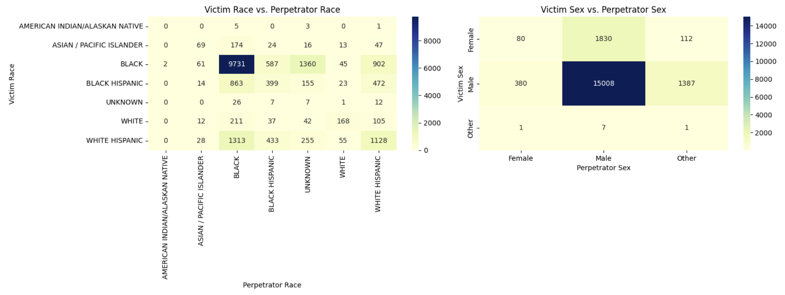
工作概述
数据分析
目录
用户分析
市场分析
财务分析
销售分析
The dense cluster for black victims perpetrators as well as white hispanic victims and perpetrators suggests that violent crimes are usually between individuals with same racial background.
Most violent crimes are male driven and intraracial, law enforcement can focus on neighborhoods where intra group violence is concentrated. Male mentorship and youth programs can also be implemented to focus on early intervention.

Slide 12
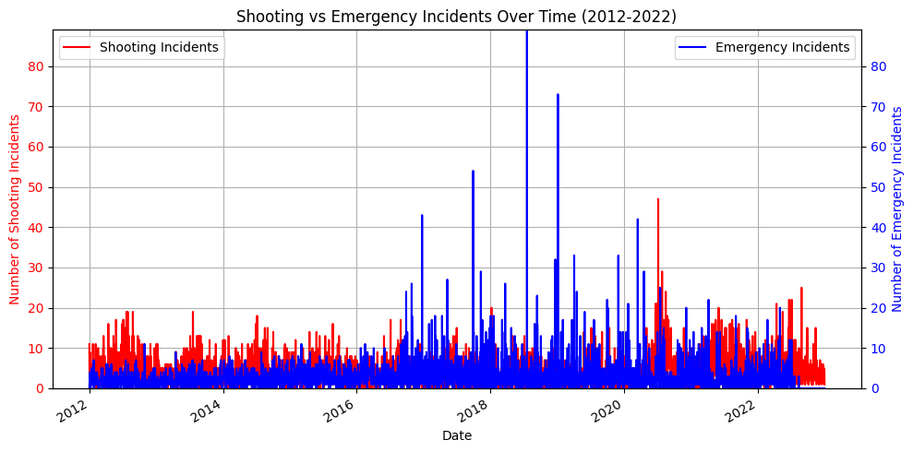
工作概述
数据分析
目录
用户分析
市场分析
财务分析
销售分析
This chart reveals a significant difference in scale, with the volume of daily emergency incidents being substantially higher and more consistent than the number of shooting incidents.
Despite sharing the same timeline, the two metrics do not show a strong direct daily correlation; a spike in shootings on a given day does not cause a noticeable corresponding spike in the overall emergency count, indicating that shootings are a small fraction of total daily emergencies.

Slide 13
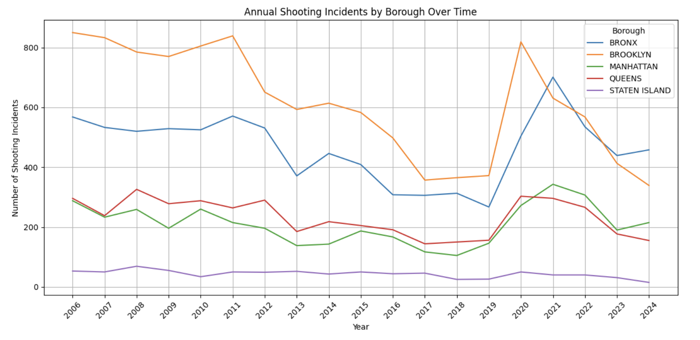

工作概述
数据分析
目录
用户分析
市场分析
财务分析
销售分析
This chart highlights a consistent disparity in shooting volumes across the city, with Brooklyn and the Bronx consistently reporting a significantly higher number of annual incidents than the other boroughs.
A prominent city-wide spike in shootings is clearly visible around the 2020-2021 period, suggesting a major event that sharply impacted all boroughs simultaneously.
The trend lines for each borough largely move in sync over the years. This indicates that city-wide factors and policies, rather than purely local issues, are the dominant drivers of the annual rise and fall in shooting incidents.

Slide 14
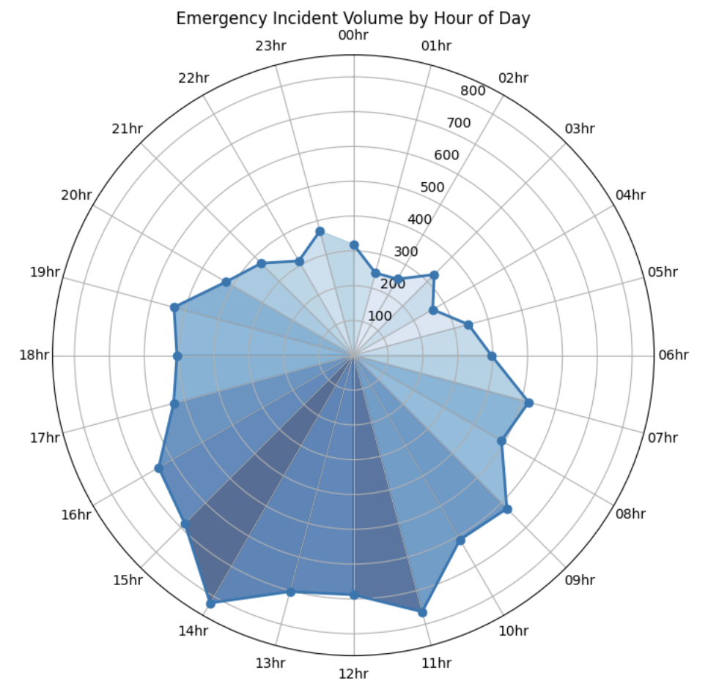
工作概述
数据分析
目录
用户分析
市场分析
Emergency incidents peak between 11 AM – 3 PM, aligning with urban activity surges and daytime mobility.
Despite general assumption of robbery or crime usually happens at night, data suggests it doesnt.
This predictable daily rhythm provides a clear model for optimizing resource allocation, allowing for staffing levels to be increased during peak hours and scaled back during periods of low demand.
财务分析
销售分析

Slide 15
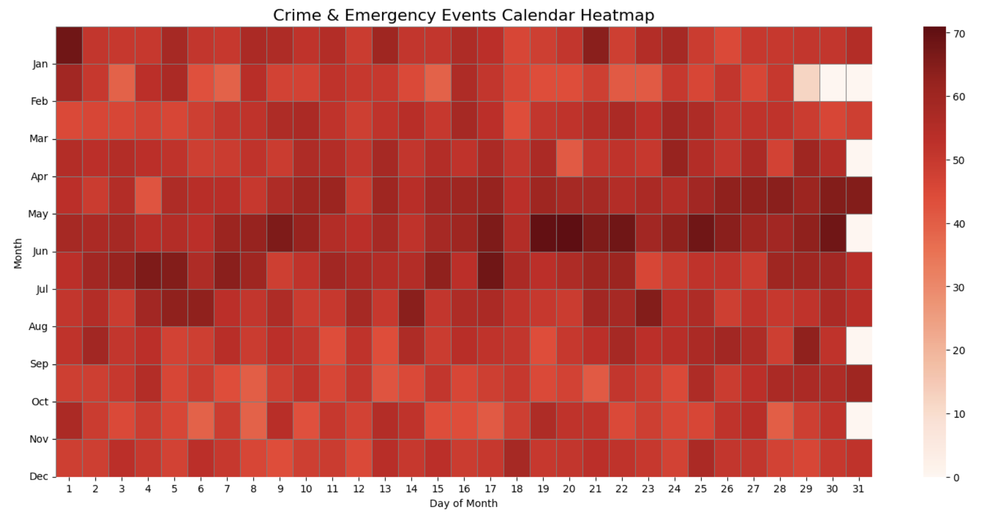

工作概述
数据分析
目录
用户分析
市场分析
财务分析
销售分析
Mid-year peaks (May–July) mark the most active crime and emergency periods, indicating summer surge effects.
Noticeable dips appear in late winter and year-end, aligning with reduced outdoor activity.

Slide 16
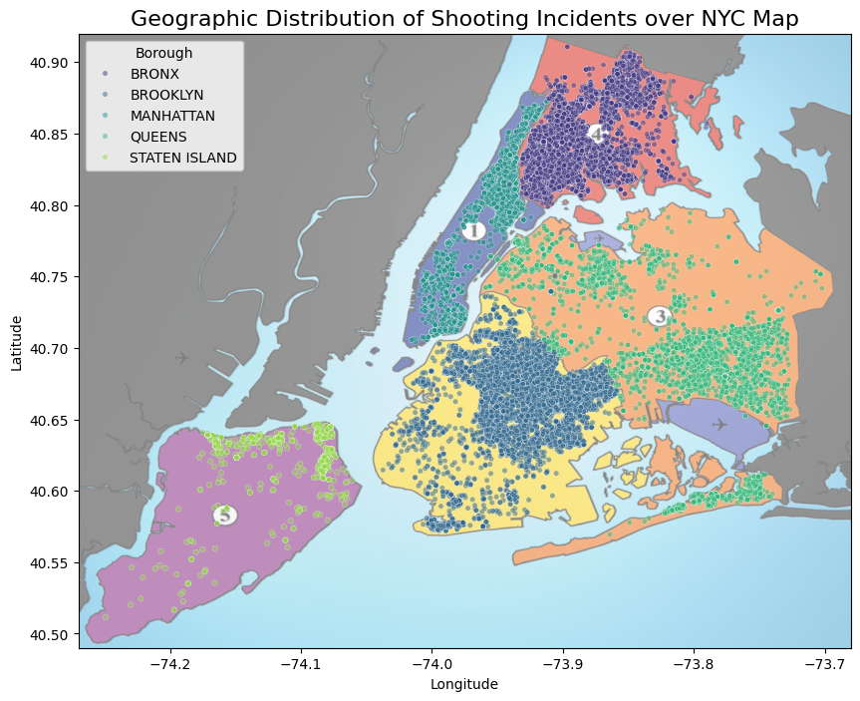
Key Insight
Eastern Queens and southern Brooklyn show a wider spread, indicating need for multiple EMS staging points.
Shootings are concentrated in central and southern Bronx and Brooklyn, warranting targeted patrols.
Emerging clusters in northern Manhattan and Queens indicate targets for early prevention efforts.
工作概述
数据分析
目录
用户分析
市场分析
财务分析
销售分析

Slide 17
Conclusion
Spatial (Manhattan – Theft Concentration)
High petty theft density in Manhattan’s retail/tourist areas → Target Theft Prevention in Manhattan Focus: retail theft programs, tourism-adjusted patrol planning.
Response Efficiency (Bronx – Slow EMS Response)
EMS response times lag behind other boroughs → Improve EMS Deployment in the Bronx
Action: predictive staffing & real-time traffic integration.
Demographic (25–44 Working-Age Group)
Arrests concentrated among working-age adults → Prioritize Prevention Programs for Ages 25–44
Action: job training, counseling, deterrence programs.
Temporal (Summer Crime Peaks)
Crime and EMS incidents surge June–August → Leverage Temporal Crime Patterns for Staffing
Action: align patrol & EMS shifts with predictable peaks.
Resource Imbalance (Low vs. High-Need Boroughs)
Staten Island consistently low-risk vs. Bronx/Brooklyn high volume → Rebalance Resources Across Boroughs
Action: shift limited resources toward high-demand areas with equity monitoring.
工作概述
数据分析
目录
用户分析
市场分析
财务分析
销售分析

